Slide 1
LINEAR DISCRIMINANT ANALYSIS
[UNIOVI]

Slide 2
Introduction
Objective
the objective of this module is to introduce and explain the basics of Linear Discriminant Analysis (LDA)
At the end of this module you will be able to:
Identify situations on which LDA can be useful
Calculate LDA functions
Interpret the results produced by descriptive and predictive LDA

Slide 3
Index
1
2
3
INTRODUCTION 1. Objectives and basic definitions
2. Motivation by an illustrative example
LDA FOR CLASSIFICATION 1. Formulation 2. An illustration
LDA FOR PREDICTION 1. Formulation 2. An illustration

Slide 4
Introduction
Basic definitions
LDA is as a method for finding linear combinations of variables that best separates observations into groups or classes, and it was originally developed by Fisher (1936)
LDA maximizes the ratio of between-class variance to the within-class variance in any particular data set. By doing this, the between-group variability is maximized, which results in maximal separability.
LDA can be used with purely classification purposes, but also with predictive objectives

Slide 5
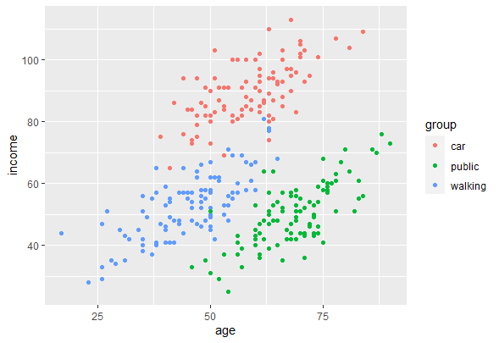
An illustrative example: transportation modes
Suppose we have a sample of individuals, and we observe the transportation mode (by car, by public transport or by walking) they usually take to move within a city
We know that the choice of the transportation mode is partially influenced by their economic status, and we observe data on their age in years and their household annual income
We want to know how these two covariates help to classify (i.e., discriminate) the individuals by assigning them to a specific category of transportation mode
Data points represented in the scatterplot

Slide 6
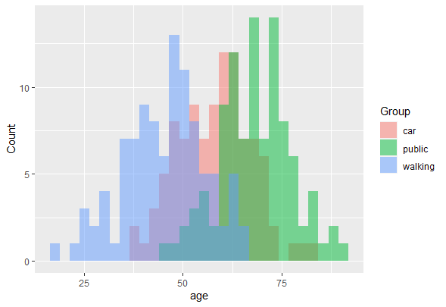
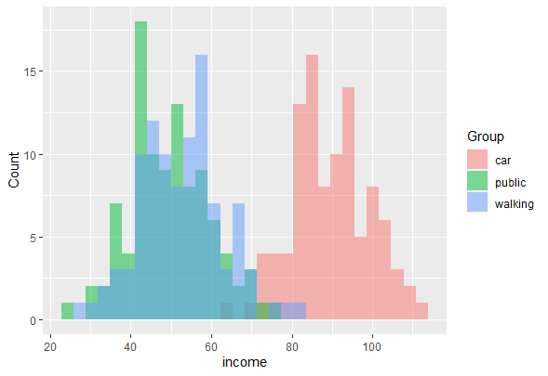
An illustrative example: transportation modes
By plotting the data, we can see that there is not perfect classification: individuals with high income tend to use cars more frequently, but there is great overlap of “walking” and “public transport” categories for those with lower incomes
Much larger overlapping among categories regarding their distribution by age

Slide 7
An illustrative example: transportation modes
Same picture if we represent the data in a scatterplot:
Individuals in households with high income tend to use cars more frequently, but there is great overlap of “walking” and “public transport” categories for those with lower incomes

Slide 8
An illustrative example: transportation modes
Same picture if we represent the data in a scatterplot:
Much larger overlapping among categories regarding their distribution by age: older individuals do not walk, but at younger values age is not a good predictor of transportation mode

Slide 9
LDA for classification: formulation
LDA functions can be recovered to help with the classification of the data based on a matrix of covariates $X$
Similar to Principal Component Analysis (PCA), LDA functions aim at finding a linear combination of the original data as:
$$LDA=u^{T}X$$
where the between-class variance ($B$) is maximized relative to the within-class variance ($W$), which can be approached as a generalized eigenvalue problem
$$u=arg \max_{u}{\frac{u^{T}Bu}{u^{T}Wu}}$$
Discriminant coordinates are obtained from the eigenvectors of $W^{−1}B$

Slide 10
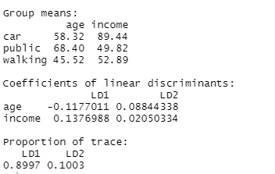
LDA for classification: formulation
Solving LDA in R can be easily done by the “lda” function within the “mass” library
The typical output shows the initial means by group, the coefficients in the LD projections and the proportion of the between variance (trace) that each LD coordinate explains
In our example, the first LD coordinate is positively correlated with income and negatively with age, and contains almost 90% of the inter-class variability
The second LD function shows positive but weaker correlation with both variables, and only accounts for approximately 10% of the between variability

Slide 11
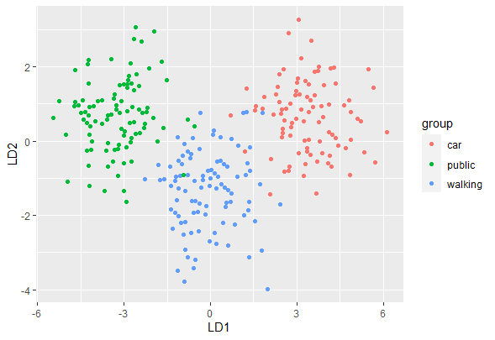
LDA for classification: an illustration
The new coordinates are produced projecting the original data points with the LDA coefficients by the expression $u^{T}X$. In these new coordinates, observations are more clearly separated across groups

Slide 12
LDA for classification: an illustration
We can identify as many LD functions as $1,…,min⁡\{p,G−1\}$, where $p$ is the number of covariates in $X$ and $G$ the number of groups or classes on which data are classified
1st LD function

Slide 13
LDA for classification: an illustration
We can identify as many LD functions as $1,…,min⁡\{p,G−1\}$, where $p$ is the number of covariates in $X$ and $G$ the number of groups or classes on which data are classified
The first LD functions accounts for the largest part of the discriminatory power, the second LD function for the second largest and so for and so on…
1st LD function

Slide 14
LDA for classification: an illustration
Note that data are better separated along the line that represents the first Linear Discriminant function than in the original coordinates (age and income)
The second LD function is orthogonal to the first one and with smaller discriminant power
2nd LD function
1st LD function

Slide 15
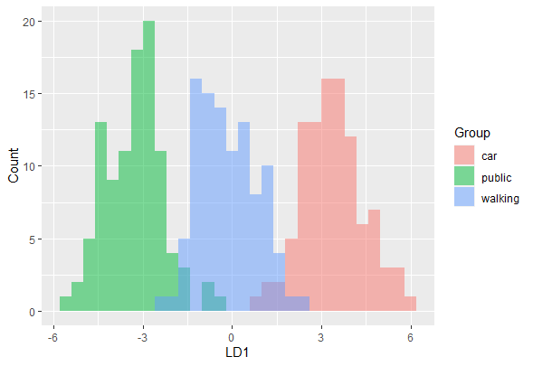
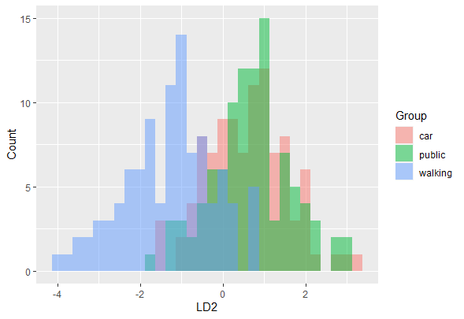
LDA for classification: an illustration
In our example, we have two LD coordinates for each individual, given their age and income. The coordinates corresponding to the first LD function have the larger discriminant power
We can display visually our data by means of histograms. If the LD functions help to discriminate, there should be no or little overlapping across the LD coordinates

Slide 16
Predictive LDA: formulation
LDA can be used not only for (descriptive) classification purposes, but also with the objective of predicting class membership
For example, suppose that we have data of the age and annual household income for an (in-sample or out-of-sample) individual, and we’d like to predict the transportation mode that this person is most likely to use
LDA can be helpful in providing us with a prediction, in a similar fashion to multinominal logit or probit models
For this predictive purpose, some assumptions are required:
groups are multivariate normal
equal variances-covariances across groups

Slide 17
Predictive LDA: formulation
Let $g$ be the number of groups and $q_{i}$ the prior probability (usually observed relative frequencies) for group $i$. Let $x$ be a vector of observations of covariates for one individual
The (posterior) probability of belonging to group $G_{i}$ conditional on $x$, $P(G_{i}|x)$, can be expressed as:
$$P(G_{i}|x)=\frac{q_{i}P(x|G_{i})}{\sum_{j=1}^{g}{q_{j}}P(x|G_{j})}$$
This is a Bayesian approach that updates the prior probabilities $q_{i}$ basing on the conditional probabilities $P(x|G_{i})$
The normality assumptions expressed before are applied here

Slide 18
Predictive LDA: formulation
Under the normality assumptions:
$$P\left(x | G_{i}\right)={\left(2π\right)}^{\left({−p}/2\right)}{\left|W\right|}^{\left({−1}/2\right)}e^{\left({{−D}_{i}^{2}}/2\right)}$$
where $\left|W\right|$ is the determinant of the within-class variance matrix and $D_{i}^{}$ is:
$D_{i}^{}={\left(x−{\overline{x}}_{i}\right)}^{T}W^{−1}$ $\left(x−{\overline{x}}_{i}\right)$
Plugging the expression of $P\left(x | G_{i}\right)$in the formula for $P(G_{i}|x)$, we have:
$$P(G_{i}|x)=\frac{q_{i}e^{\left({{−D}_{i}^{2}}/2\right)}}{\sum_{j=1}^{g}{q_{j}}e^{\left({{−D}_{j}^{2}}/2\right)}}$$

Slide 19
Predictive LDA: an illustration
The LDA routine in R can produce posterior probabilities basing on the assumptions and the formulation detailed before
The LDA functions allows for predicting the most likely class membership for any individual, given a vector of covariates (age and household income in the example)
As an illustration, the table displayed in the next slide shows the predicted probabilities for each group for a subset of individuals in the sample. The priors $q_{i}$ are assumed to be identical for each one of the three transportation modes ($q_{i}=1/3$)
The predicted class corresponds to the highest $P(G_{i}|x)$ for each individual

Slide 20
Predictive LDA: an illustration
The predicted class corresponds to the highest $P(G_{i}|x)$ for each individual
In most of cases, LDA correctly predicts the group to which each individual belongs

Slide 21
Predictive LDA: an illustration
The predicted class corresponds to the highest $P(G_{i}|x)$ for each individual
In most of cases, LDA correctly predicts the group to which each individual belongs
There are some cases (marked in red) for which LDA does not predict correctly. These cases correspond to the overlapping observations that still remain in the LDA classification

Slide 22
Summary
Goal of LDA
LDA for classification: formulation
Predicitive LDA: formulation
Assumptions required
LDA for classification: interpreting the results
Predictive LDA: interpreting the predicted classes

Slide 23
Self-assessment test
LDA is a statistical technique that allows for:
A Classification of data into groups
B Predicting class membership
C Both answers are true
Assumptions required to apply LDA for predictive purposes are:
A Multivariate normality across groups
B equal variances-covariances across groups
C Both answers are true
3. LDA bases on maximizing the ratio:
A Between-groups versus within-class variability
B Within-groups versus total variability
C Total versus Within-groups variability

Slide 24
Self-assessment test
LDA is a statistical technique that allows for:
A Classification of data into groups
B Predicting class membership
C Both answers are true
Assumptions required to apply LDA for predictive purposes are:
A Multivariate normality across groups
B equal variances-covariances across groups
C Both answers are true
3. LDA bases on maximizing the ratio:
A Between-groups versus within-class variability
B Within-groups versus total variability
C Total versus Within-groups variability

Slide 25
Thank you!

