Slide 1
Data visualization– dashboards
By [ASE]

Slide 2
Index
1
2
3
Unit 1 - Introduction
Defining a dashboard
The purpose and objectives of making a dahsboardSection
Knowing and addressing the audience
Unit 2 - Creating an effective dashboard
1. Types of dashboards
2. Structure of a dashboard
3. Principles of design and functionality of a dashboard
Unit 3 – Case study
Defining the problem
Creating a dashboard for the Orders database
Ensuring dashboard interactivity in Tableau

Slide 3
Unit 1: Introduction
Section 1 - Defining a dashboard
What is a dashboard?
Dashboards have become standard tools used in business over the last 10 years
A dashboard represents a visualization of the most important information needed to achieve one or more objectives; information must be systematized and arranged on a single screen so that it can be monitored at a glance
(Stephen Few, Information Dashboard Design, 2006)
Data tells you what is happening, but a story told with the help of a dashboard tells you why it matters, why that data is important

Slide 4
Unit 1: Introduction
Section 2: - The purpose and objectives of creating a dashboard
Contents
Defining the purpose of a dashboard
The starting point in creating a dashboard is defining its purpose and the objectives it will achieve.
The key questions to ask before creating a dashboard are:
What is the audience?
What added value will the dashboard have?
What type of dashboard is needed / will I realize?
Who ? What ? Why ? How will the data be used to achieve the objective?

Slide 5
Unit 1: Introduction
Section 2: - The purpose and objectives of creating a dashboard
Contents
What added value will the dashboard bring?
Dashboards can serve many purposes. Before creating a dashboard, the reasons for creating the dashboard must be clearly considered:
Helping management define what is important
Educating people in the company about the important things
Setting goals for specific employees / groups of employees
Encouraging specific actions in a timely manner
Highlighting issues and setting alerts when they occur
Communicating progress and what's happening in the company
Providing an interface for interacting and analyzing the most important data in the business.

Slide 6
Unit 1: Introduction
Section 3 - Knowing and addressing the audience
Contents
Knowing and addressing your audience
Role
What decisions need to be made?
What questions need answers?
Workflow
In what context will the dashboard be used?
What information do they use on a daily basis? How much time do they have to analyze the numbers?
Comfort level with numbers and data:
How familiar are they with using data?
Do they have expertise in using the software? Do they enjoy analyzing numbers?
Business and data expertise
How familiar are they with key performance indicators?
Are they familiar with industry and company specific terminology?

Slide 7
Unit 2: Creating an effective dashboard
Section 1 - Types of dashboards
What kind of dashboard will I create?
Depending on the purpose:
General: Presenting of information at the level of the entire organization
Specific: Focusing on a specific function, process, product, etc.
Depending on the role in the business:
Strategic: Provides high-level, overall, long-term exposure to performance
Operational: Provides focused, short-term and tactical exposure to performance
Depending on the time horizon:
Historical: which analyzes the trends over time
Snapshot: Analyzes performance only for a specific moment in time
Real-time: Monitors performance as it unfolds
Predictive: Uses past performance information to predict the future.

Slide 8
Unit 2: Creating an effective dashboard
Section 1 - Types of dashboards
What kind of dashboard will I create?
Depending on the level of customization:
Universal: One version for all users
Customizable: With features that allow users to modify the view to suit their needs
Depending on the level of detail:
Overall: Only high-level key figures are presented
Drill-down: Allows the user to drill down into the data to get a broader context.
Depending on the point of view:
Descriptive: The dashboard tells the user explicitly how to interpret the data
Explorer: Interpretation of results is up to the user

Slide 9
Unit 2: Creating an effective dashboard
Section 2 - The structure of a dashboard
The structure of a dashboard
The content of a dashboard should be organized in such a way that it reflects the nature of the information and helps effective monitoring.
Information cannot be placed anywhere in the dashboard, nor can sections of the view be placed just to fill the available space.
Elements that are related to each other should be positioned close to each other.
Important elements should be larger, more easily visible than less important elements.
Objects to be analyzed in a certain order should be arranged in such a way that the sequence is visually suggested.
(Stephen Few, "Pervasive Hurdles to Effective Dashboard Design", Visual Business Intelligence Newsletter, 2007)

Slide 10
Unit 2: Creating an effective dashboard
Section 2 - The structure of a dashboard
The structure of a dashboard
Finding the right dashboard structure is one of the biggest challenges in building it.
The structure of the dashboard is also an opportunity to define the best way to look at the problem or the business.
The way in which the information is placed in the dashboard also determines the way in which the audience understands the transmitted message. In other words, for the user, the structure has a guiding role in navigating the dashboard.
A suitable structure for a dashboard requires a very good understanding of how the measured system (the business) works.
Depending on the structure, we can have three types of dashboards: flow, relational, grouping.

Slide 11
Unit 2: Creating an effective dashboard
Section 2 - The structure of a dashboard
The structure of a dashboard
A dashboard with a flow-based (flow) structure emphasizes the sequence of events or actions over time.
Examples:
Steps in the process of providing customer support
Operational processes
Sales process (From leads through sales channels).
A dashboard with a relationship-based structure highlights the links between entities or certain measures.
These relationships can be mathematical, geographical, organizational or functional.
The dashboard in the accompanying example exposes the relationships between financial indicators so that users can understand the factors that influence net income.
The structure of a grouping dashboard involves grouping related information into categories or hierarchies.
Placing similar elements together can create logic and accessibility to a dashboard that might otherwise seem cluttered.

Slide 12
Unit 2: Creating an effective dashboard
Section 3 - Principles of design and functionality of a dashboard
Design principles of a dashboard
It is advisable that the dashboard design should focus on only a few design principles that will be followed
A. Compact design / Modular design
The compact nature of a dashboard means that the visualization can be comprehended by the human brain
Some dashboards become too large and difficult to follow in an effort to include as much information as possible
Dashboards can be divided into smaller pieces, each of which answers a question.
B. Gradual Disclosure of Information.
Information is disclosed as the user expresses interest.
The user is not overwhelmed from the start with all the information
Increasing the level of detail is generally done from:
Key indicators →
The context of the indicators →
Details on indicators

Slide 13
Unit 2: Creating an effective dashboard
Section 3 - Principles of design and functionality of a dashboard
Design principles of a dashboard
C. Guidance of attention
Using visual cues and functionality to direct the user's attention to the most important things
Among the mechanisms that can be used are: alerts, positioning on the page, careful use of color and fonts.
D. Support for ease of use
Avoiding overloading the view, minimizing the number of actions for each task so that new users are encouraged to use the view
Providing clear and concise descriptions of what the items on the dashboard mean.
E. The possibility of personalization
Ensuring the flexibility to make the dashboard relevant to different users.
It is generally done by using filters
F. Explanations Before Information
Where context and explanations are needed to understand new and unfamiliar events
Sometimes leaving the interpretation of data up to the user can lead to wrong conclusions and confusion.

Slide 14
Unit 2: Creating an effective dashboard
Section 3 - Principles of design and functionality of a dashboard
Elements that ensure the functionality of a dashboard
Ability to detail
The ability to move from a summary indicator or representation to indicators that provide more detail, more context on the information
Filters
It allows users to define what is displayed in the dashboard according to their needs and interests.
Filters can be global (applicable to the entire dashboard) or local (specific to a chart)
Ensuring comparisons
The ability to view two or more sets of data side by side
Alerts
Highlight information based on predefined criteria.
For example, an alert can be triggered if an indicator exceeds a certain threshold value.

Slide 15
Unit 2: Creating an effective dashboard
Section 3 - Principles of design and functionality of a dashboard
Mistakes to avoid when creating a dashboard
Starting with a far too complex dashboard (more prototyping, testing and tweaking is recommended).
Using indicators that no one understands.
Cluttering the dashboard with unimportant graphics and stylized elements that are difficult to interpret. The dashboard must remain simple (not simplistic!) and visually appealing
Underestimating the time and resources needed to create the dashboard
Lack of synchronization between included indicators and objectives.
Use of ineffective graphics that have an uninspired design (3D, strong colors, pie charts with many categories).
Sending fake messages with the dashboard. You need to make sure that the graphics don't send the wrong message that can be perpetuated
Creating a false narrative based on the dashboard, creating false scenarios for users based on a misinterpretation of the data.

Slide 16
Unit 2: Creating an effective dashboard
Section 3 - Principles of design and functionality of a dashboard
The best practices in creating a dashboard
1. Including the right indicators in the dashboard
Including the right indicators in the dashboard is essential
Indicators must be essential and relevant to the goals of the dashboard and to the context
2. Inclusion of visual elements
Dashboards must be easy to read and quick to interpret
The inclusion of tables with a lot of information will be avoided, as it makes it difficult to get the message across
Elements of visual perception will be used such as: shapes, colors, lines, shades of colors, etc.
Avoid: 3D graphics, graphics that are not commonly used, overly stylized elements.
3. Inclusion of interactive elements
Dashboards need to be interactive, meaning users need to customize them to get the information they need. Interactive dashboards that contain many visual elements should allow the audience to perform basic analytical tasks, such as: filtering elements, drilling down information, or examining the data behind the graphs. Interactivity should be easily achieved with a minimum of training.
4. Keeping dashboard information current
5. The dashboard must be easy to access and use

Slide 17
Unit 3: Case Study
Section 1: Defining the problem
Context
The company's management is interested in monitoring sales realized by county, as well as highlighting the counties and product categories with a low profit rate, and what is the monthly dinamics of sales and profit rate in 2018. At the county level, the interest is on counties that have registered loss, those with profitability up to 10%, between 10% and 20% and over 20%.
At the level of development regions, the profit rate must be above 20% for the regional coordination team to meet the profitability target. Of particular interest are the loss-making regions.
The management also wants to know which counties record the highest sales reported per customer (top / ranking), with the possibility of viewing by customer segments and product categories.

Slide 18
Unit 3: Case Study
Section 1: Defining the problem
Indicators to be included
To create a dashboard that meets the needs of the audience, we will need to include the following indicators:
Total sales by county
Profit rate by counties / product categories / monthly
Profit rate at the level of regions (highlighting those with a profit rate above 20% and with a negative profit rate).
Sales by customer / customer segment / product category. (ranking counties)
The proposed structure of the dashboard
Based on the indicators and the level of detail required, we opt for the following component charts:
Scatter plot to highlight the relationship between profit and sales by county
Map showing profit rate by county (color) and sales (bubble chart overlay)
Bar chart with sales per customer (ranking)
Table showing whether profitability targets were met by region.
Required filters: Time – months (depending on the order date), Customer segment, Product category
Type of dashboard: General, Customizable by the user (using filters), Detailed, Explorer

Slide 19
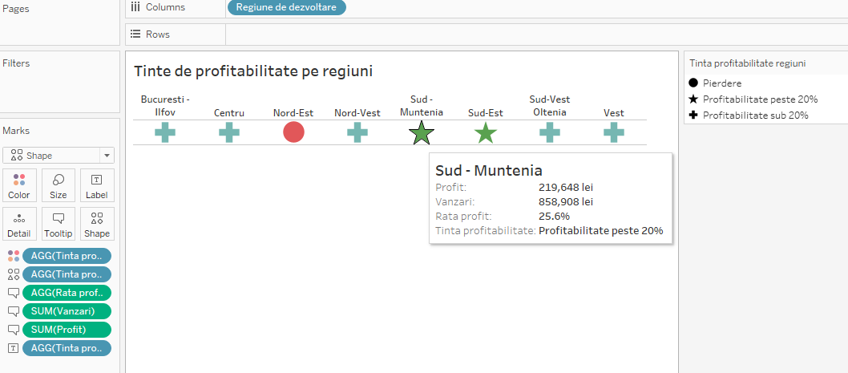
Unit 3: Case Study
Section 2: Creating a dashboard for the Orders database
Creating a dashboard for the Orders database
a) Table showing whether the profitability targets by region have been met.

Slide 20
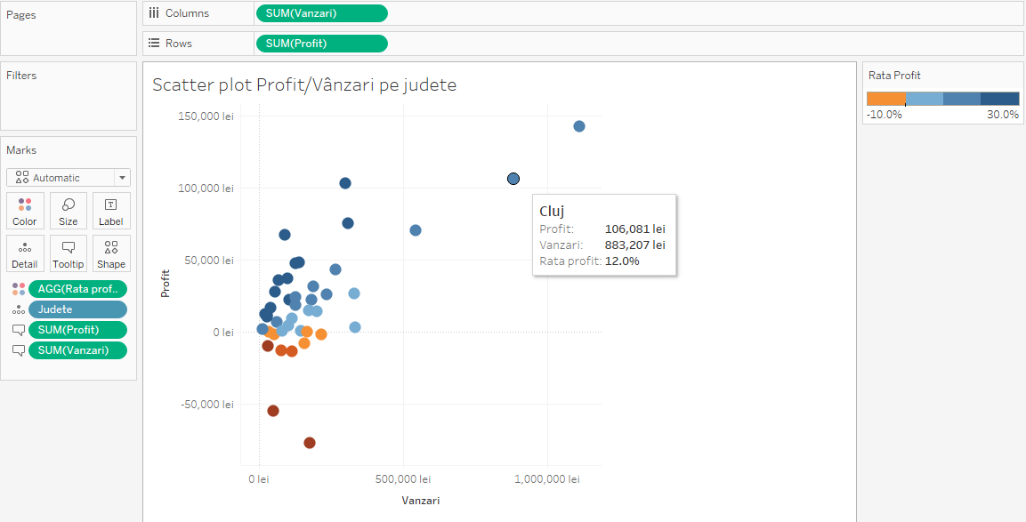
Unit 3: Case Study
Section 2: Creating a dashboard for the Orders database
b) Scatter plot to highlight the relationship between profit and sales by county

Slide 21
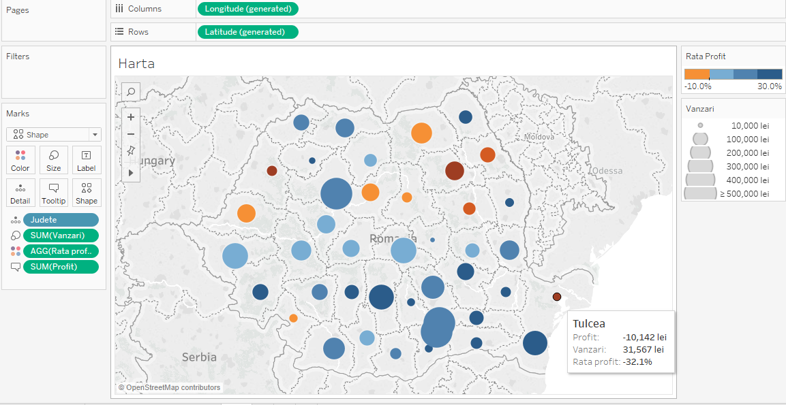
Unit 3: Case Study
Section 2: Creating a dashboard for the Orders database
c) Map highlithing the profit rate by county (color) and sales (bubble chart overlay)

Slide 22
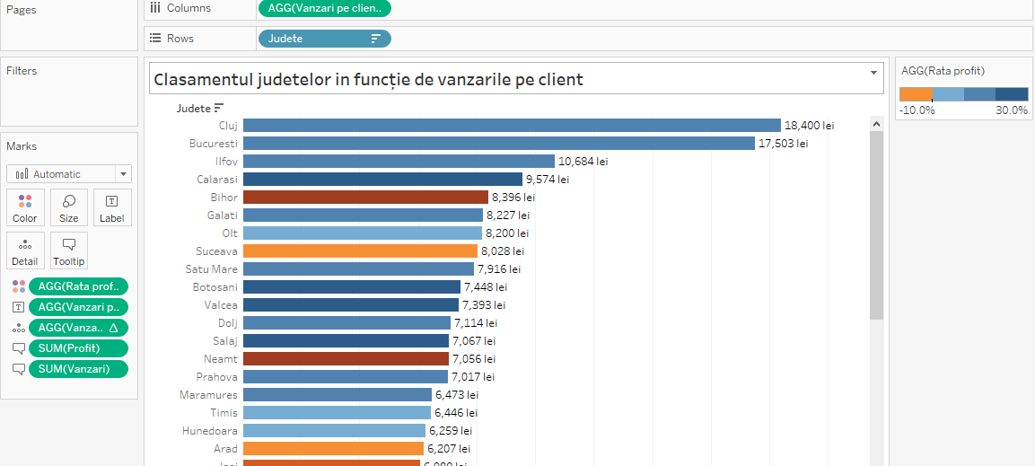
Unit 3: Case Study
Section 2: Creating a dashboard for the Orders database
d) Bar chart with sales per customer (ranking)

Slide 23
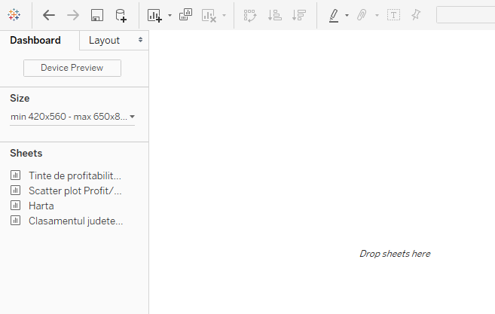
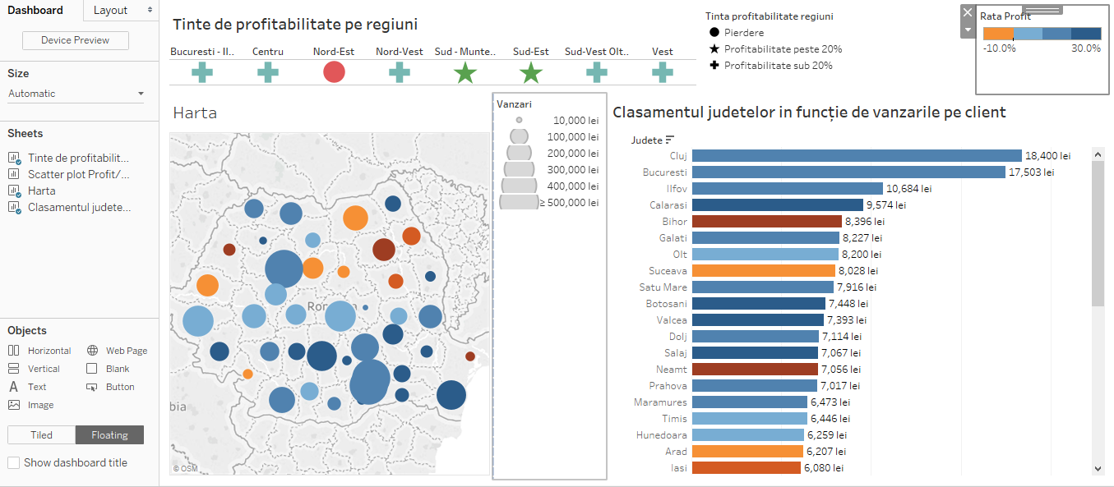
Unit 3: Case Study
Section 3: Ensuring dashboard interactivity in Tableau
Building the dashboard

Slide 24
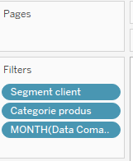
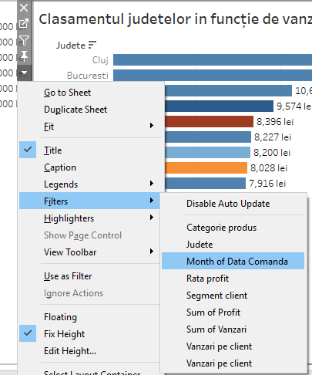
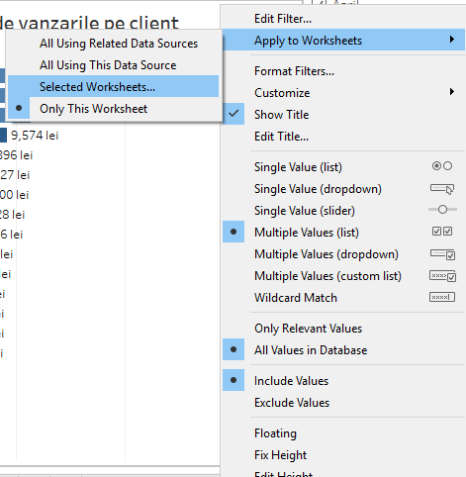
Unit 3: Case Study
Section 3: Ensuring dashboard interactivity in Tableau
Using interactive elements – adding filters and actions to the dashboard

Slide 25
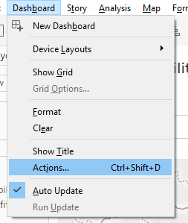
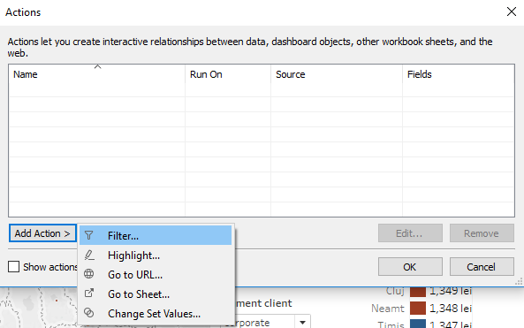
Unit 3: Case Study
Section 3: Ensuring dashboard interactivity in Tableau
Adding actions to the dashboard
Actions are about correlating different information in the dashboard. For example, suppose we notice that a region is not meeting its profitability target. Then, it would be interesting that when selecting a region (from the graph located at the top of the dashboard), we limit the information from the other two representations to that region.
This can be done through an Action

Slide 26
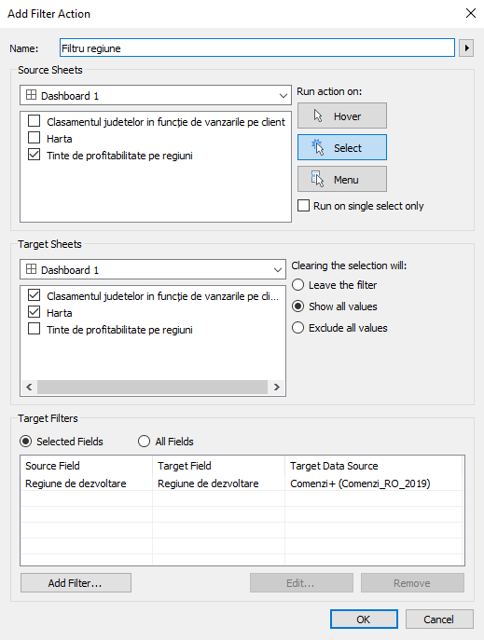
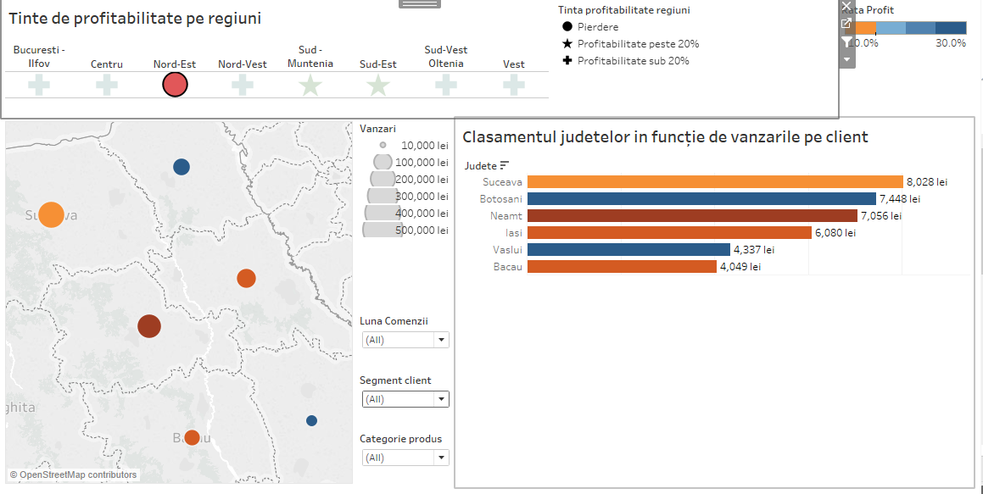
Unit 3: Case Study
Section 3: Ensuring dashboard interactivity in Tableau

Slide 27
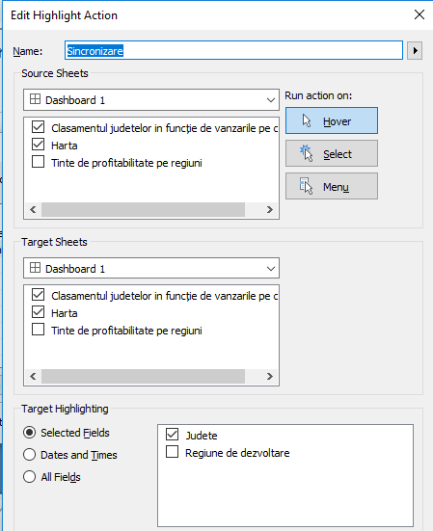
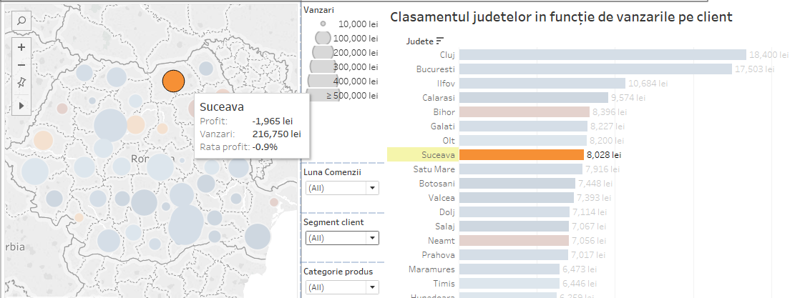
Unit 3: Case Study
Section 3: Ensuring dashboard interactivity in Tableau

Slide 28
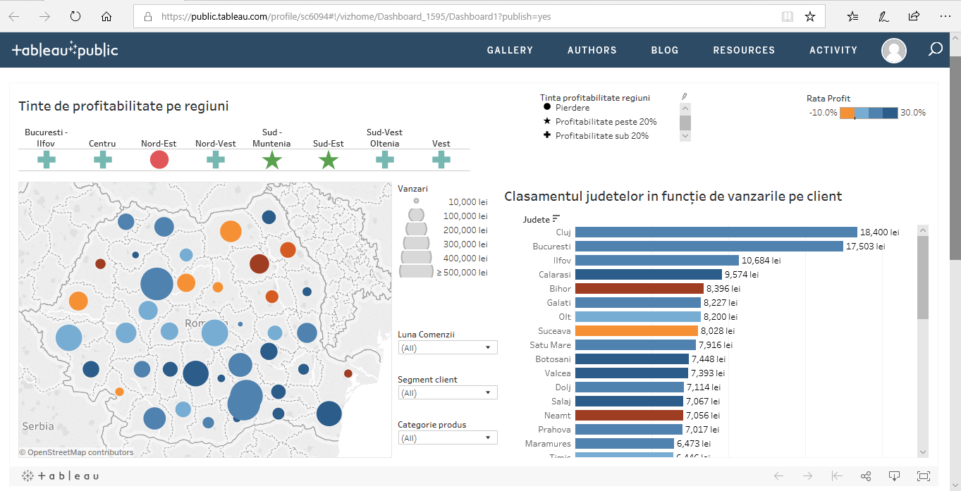
Unit 3: Case Study
Section 3: Ensuring dashboard interactivity in Tableau

Slide 29
Summing up
Defining the objectives of the dashboard
Role, audience
Choosing the graphics so that they meet the objectives as well as possible
Providing interactivity elements (filters, actions)
Choosing the right indicators to be included in the dashboard
Creating graphics and arranging them in the dashboard
Ensuring compliance with design principles and good practices

Slide 30
Self-assessment test
To create effective dashboards, it is recommended:
A. Including stylized elements in graphics.
B. Using as many interactive elements as possible
C. Including as much information as possible to better transmit the message.
2. Which of the principles below cannot be applied to the creation of a dashboard:
A. Guiding the attention to important items in the view
B. Using a compact design for the dashboard
C. Including filters that can only be used by the dashboard creator, not the user.
3. One of the best practices in creating dashboards is:
A. Include tables of information
B. Use of 3D graphics and stylized elements
C. Keeping dashboard information up-to-date

Slide 31
Thank you!

