Slide 1
GENERALIZED LINEAR MODELS: ANOVA
[UNIOVI]

Slide 2
Introduction
Objective
the objective of this module is to presents the basic concepts of the one-factor and two-factors Analysis of Variance (ANOVA), which can be understood as a basic linear model
At the end of this module you will be able to:
How ANOVA can be useful to test if there are differences between the mean value of a continuous variable across different levels of one or several categorical variables
Understand and identify the conditions required to apply these techniques
Conduct one-way and multiple Analysis of Variance and interpret the results obtained

Slide 3
Index
1
2
3
INTRODUCTION
1. Motivation and basic definitions
2. Conditions for applying ANOVA required
ONE-WAY ANOVA
1. Decomposing the variability
2. Conducting and interpreting an ANOVA test
TWO-FACTOR ANOVA
1. Multiple sources of variation
2. Conducting the two-factor ANOVA test

Slide 4
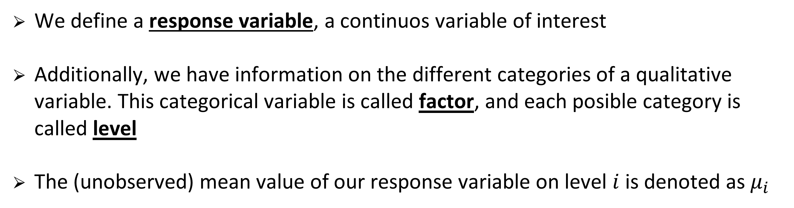
Introduction
Basic definitions
We define a response variable, a continuos variable of interest
Additionally, we have information on the different categories of a qualitative variable. This categorical variable is called factor, and each posible category is called level
The (unobserved) mean value of our response variable on level $i$ is denoted as $μ_{i}$

Slide 5
Introduction
Motivation
The GLM techniques presented here in the form of ANOVA allow for responding to potentially interesting questions. Some examples:
  Are male and female workers in a region making the same mean annual wage?
  Do the students of a course following different teaching methods getting the same mean grade?
  Is the mean weekly consumption of certain medicine different across age groups and/or gender?
  One-factor ANOVA is fine for questions 1 and 2, while question 3 requires of two-factor ANOVA

Slide 6
One way ANOVA
(b) assignments
Suppose we have a sample of students, all they taking the same course, distributed across classes a, b and c
Students on class (a) follow a traditional teaching method based on lectures. Students on (b) follow a system based on assignments, while students on (c) follow a mixed system
We have sample data on the distribution of their grades (scale 0 to 10) as represented in the boxplots
We want to test if there are statistically significant differences in their mean grades, depending on the teaching method applied
GRADE
(a) traditional
(c) mixed
Factor
Teaching method
Levels
(a) lectured-based; (b) based on assignments; (c) mixed system
Response Variable
Grade

Slide 7
One way ANOVA
Goal. To test for the effect of an independent variable (FACTOR) classified into k several categories (LEVELS) on a numerical dependent variable (RESPONSE VARIABLE)
It bases on decomposing total sample variability
We can approach this problem as a statistical hypothesis test of a null hypothesis (H0; our default) versus and alternative (H1; an alternative worldview)
The test is formulated in terms of the means of the response variable across the levels of our factor

Slide 8
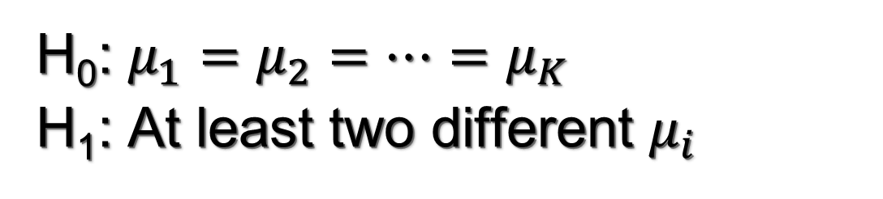
One way ANOVA
The ANOVA test can be formulated as follows:
H₀: $μ_{1}=μ_{2}=…=μ_{K}$
H₁: At least two different $μ_{i}$
The assumptions required to conduct the ANOVA test are
Normal populations: the distribution of the response variable on each and every level should be normal
Equality of variances: the variances of the response variable across levels must be the same
Independent simples: the sample data on each level of the factor is nor correlated with the other sample data (collected from the other levels)

Slide 9
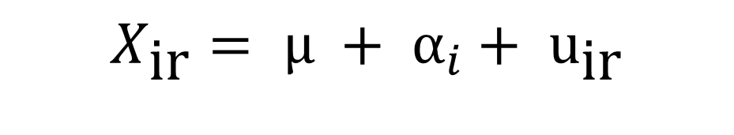
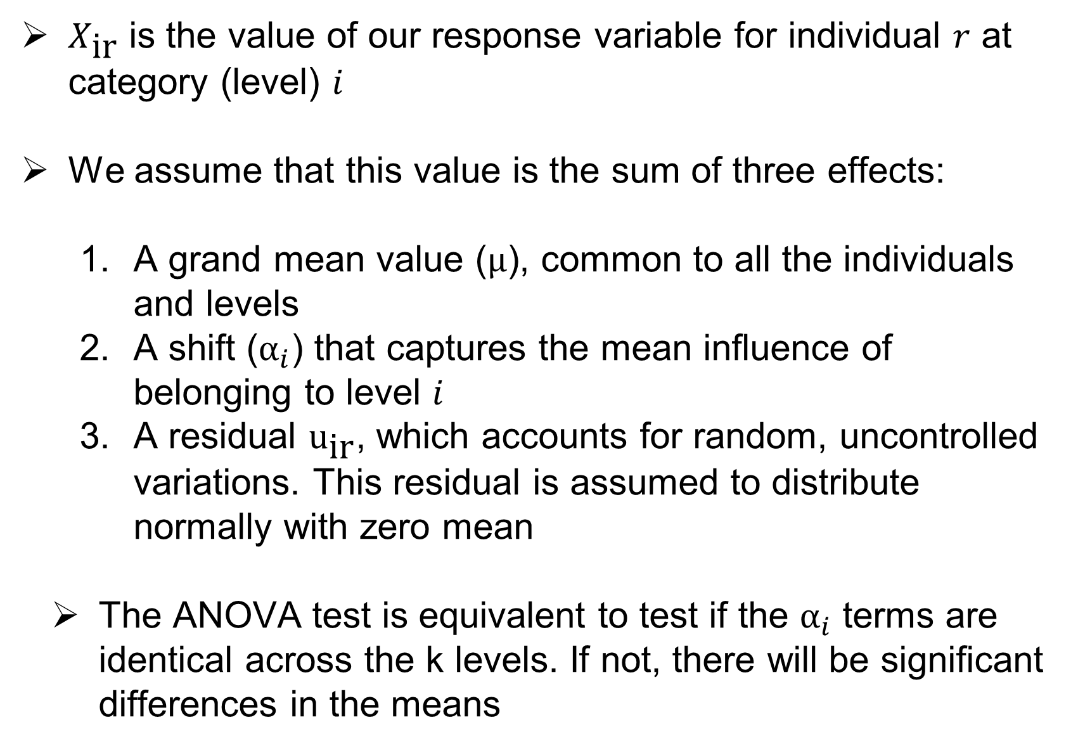
One way ANOVA
$X_{\text{ir}}$ is the value of our response variable for individual $r$ at category (level) $i$
We assume that this value is the sum of three effects:
A grand mean value ($\text{μ}$), common to all the individuals and levels
A shift (${\text{α}}_{i}$) that captures the mean influence of belonging to level $i$
A residual ${\text{u}}_{\text{i}\text{r}}$, which accounts for random, uncontrolled variations. This residual is assumed to distribute normally with zero mean
The ANOVA test is equivalent to test if the ${\text{α}}_{i}$ terms are identical across the k levels. If not, there will be significant differences in the means
Effect of level i
Residual
$$X_{\text{i}\text{r}}= \text{μ} + {\text{α}}_{i}+ {\text{u}}_{\text{i}\text{r}}$$

Slide 10

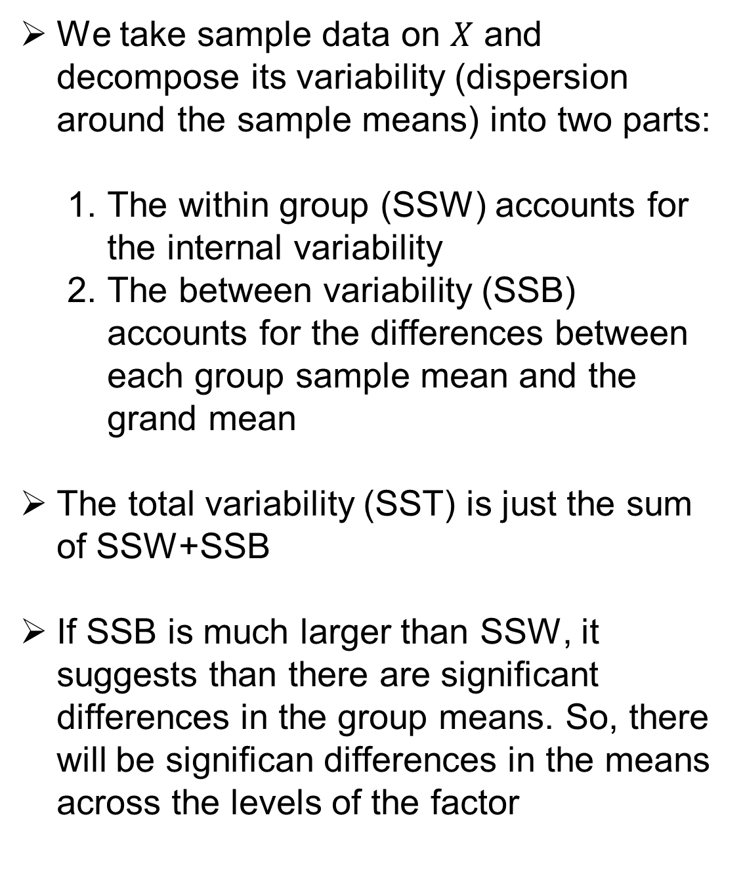


One way ANOVA: Decomposing the variability
Within-group variability (SSW)
We take sample data on $X$ and decompose its variability (dispersion around the sample means) into two parts:
The within group (SSW) accounts for the internal variability
The between variability (SSB) accounts for the differences between each group sample mean and the grand mean
The total variability (SST) is just the sum of SSW+SSB
If SSB is much larger than SSW, it suggests than there are significant differences in the group means. So, there will be significan differences in the means across the levels of the factor
$${\overline{X}}_{1}$$
Group 1. Sample




Group 2. Sample
$${\overline{X}}_{2}$$
Between-group variability (SSB)
■
■
■
■
■
■
Overall sample
$$\overline{X}$$

■

■
■


■
■
■
TOTAL Variability (SST)

Slide 11
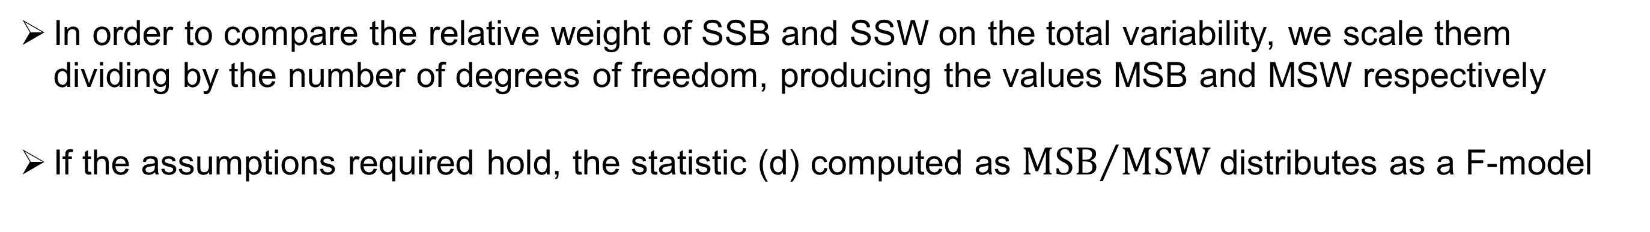
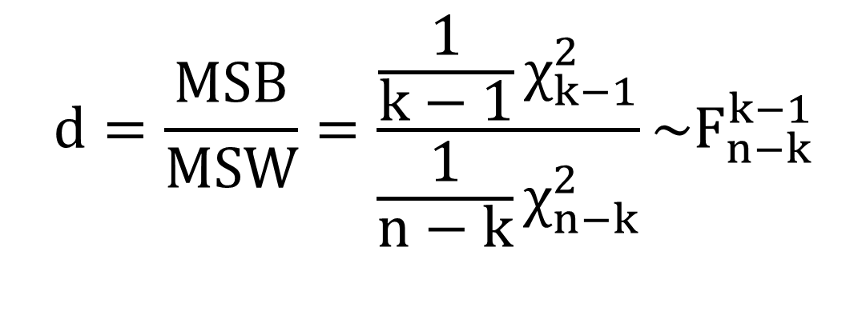
One way ANOVA: Decomposing the variability
In order to compare the relative weight of SSB and SSW on the total variability, we scale them dividing by the number of degrees of freedom, producing the values MSB and MSW respectively
If the assumptions required hold, the statistic (d) computed as ${MSB}/{MSW}$ distributes as a F-model
$$d=\frac{MSB}{MSW}=\frac{\frac{1}{k−1}χ_{k−1}^{2}}{\frac{1}{n−k}χ_{n−k}^{2}}\sim F_{n−k}^{k−1}$$

Slide 12
One way ANOVA: Conducting an ANOVA test
This statistic allows for making a decision about the test: the higher its value, the larger (relatively) is the between part when compared with the within variability
how can we know if d is high or not? By calculating the p-value associated to this test
we compute the p-value (the probability at the right tail of the relevant F-distribution) and if this p-value is low we reject the null (i.e., there are significant differences in the mean across levels)
p = P(F_{k-1,n-k}> d*)

Slide 13
One way ANOVA: Conducting an ANOVA test
Let’s go back to our example: are the mean grades significantly different across teaching methods?
We take a sample of 12 students, with grades distributed as in the table
The default (null hypothesis H₀) is that the means are equal
Assuming that we have equal variances and normal distributions, we conduct the ANOVA test
Teaching method
a | b | c
5 6.5 5.5 7 | 7.5 7 9.5 9 | 8 8.5 8 9
Anova Table(R output)
p-value is low; H₀ is rejected; there are significant differences

Slide 14
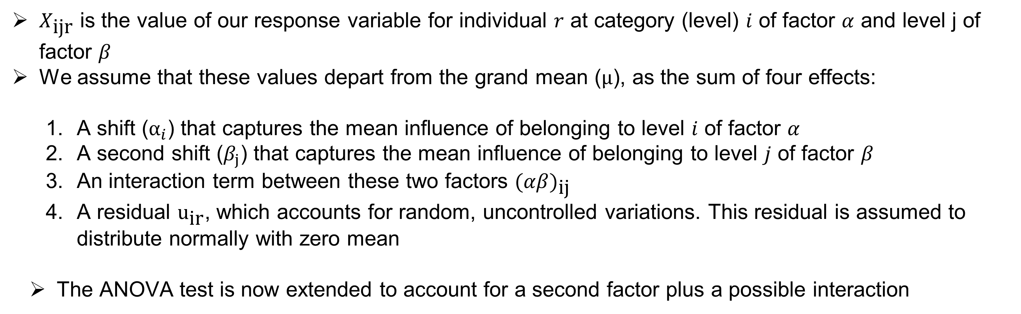
TWO-FACTOR ANOVA: Multiple sources of variation
$X_{\text{ij}\text{r}}$ is the value of our response variable for individual $r$ at category (level) $i$ of factor $α$ and level j of factor $β$
We assume that these values depart from the grand mean ($\text{μ}$), as the sum of four effects:
A shift (${\text{α}}_{i}$) that captures the mean influence of belonging to level $i$ of factor $α$
A second shift ($β_{j}$) that captures the mean influence of belonging to level $j$ of factor $β$
An interaction term between these two factors $(αβ)_{\text{ij}}$
A residual ${\text{u}}_{\text{i}\text{r}}$, which accounts for random, uncontrolled variations. This residual is assumed to distribute normally with zero mean
The ANOVA test is now extended to account for a second factor plus a possible interaction
$$X_{\text{ijr}} = μ + α_{i} + β_{j} + (αβ)_{\text{ij}} + {\text{u}}_{\text{ijr}}$$
Residual
Effect of level i of factor α
Effect of level j of factor β
Interaction

Slide 15
TWO-FACTOR ANOVA: Conducting the test
Now the comparisons between the different parts of the variability are more complex
Each source of variation is compared (conveniently scaled by the number of degrees of freedom) with the residual variance
The intuition is the same as in one-factor ANOVA, but there are three different tests

Slide 16
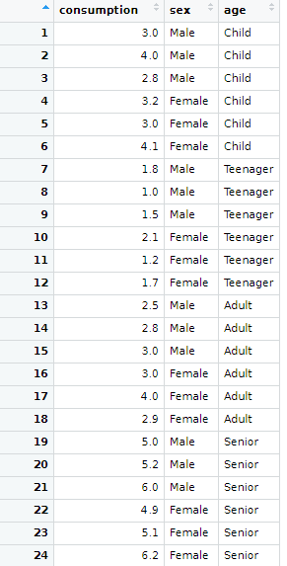
TWO-FACTOR ANOVA: example in R
A health institution wants to analyze the potential influence of age and sex on the use of a medicine. A sample survey is conducted for this purpose and users were grouped by age into four categories (children, teenagers, adults, seniors) and gender
A sample survey is conducted for this purpose and users were grouped by age into four categories (children, teenagers, adults, seniors) and gender. A sample of 24 individuals was drawn, independently selecting 3 individuals by gender and age group.
The response variable is the monthly consumption of this medicine (in €),

Slide 17


TWO-FACTOR ANOVA: example in R
We first test if the assumptions required actually hold, by running normality and equal-variances test. Normality tests (across all the age groups and the two genders):
Both test are passed, so the two-factor ANOVA can be conducted

Slide 18
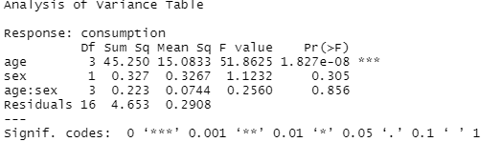

TWO-FACTOR ANOVA: example in R
The two-factor ANOVA is conducted by running this piece of code:
R produces the output of this analysis in the form of a table as below:
The results show that mean values of the response variable are different across the four levels of factor “age”, but this is the only case when we have a low p-value. We do not find significant differences in the mean consumption by gender or across the interactions between age-group and gender

Slide 19
Summary
Goal of ANOVA
Decomposing variability: between and within variations
ANOVA table
Assumptions required
Extension to two-factor ANOVA
Conclussions of the tests

Slide 20
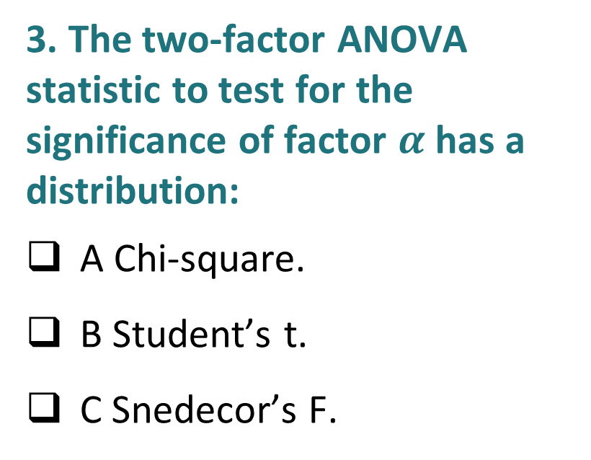
Self-assessment test
In one-factor ANOVA, the residuals:
A Are assumed to be correlated
B Are assumed to be normal
C We do not need any assumptions on the residuals
2. The null hypothesis in a one-factor ANOVA states that:
A All the means are the same across levels
B There are only two means that are the same
C All the means are different
3. The two-factor ANOVA statistic to test for the significance of factor $α$ has a distribution:
A Chi-square.
B Student’s t.
C Snedecor’s F.

Slide 21

Self-assessment test
In one-factor ANOVA, the residuals:
A Are assumed to be correlated
B Are assumed to be normal
C We do not need any assumptions on the residuals
2. The null hypothesis in a one-factor ANOVA states that:
A All the means are the same across levels
B There are only two means that are the same
C All the means are different
3. The two-factor ANOVA statistic to test for the significance of factor $α$ has a distribution:
A Chi-square.
B Student’s t.
C Snedecor’s F.

Slide 22
Thank you!

