Slide 1
SAMPLING THEORY
[UNIOVI]

Slide 2
Introduction
Objective
the objective of this module is to introduce and explain the basics of sampling theory
At the end of this module you will be able to:
Understand the differences between population and samples
Know the most commonly applied sampling techniques
Find optimal sample sizes

Slide 3
Index
1
2
3
INTRODUCTION 1. Basic definitions and objectives 2. Populations v. samples
SAMPLING TECHNIQUES 1. Simple random sampling 2. Stratified sampling
CALCULATING SAMPLE SIZES 1. Finding optimal sample size for simple random sampling 2. Finding optimal sample size for stratified data

Slide 4
Introduction
Objectives
In this module we will study:
The differences between sample-based data and population-based data
The most commonly applied sampling techniques: simple and statified sampling
The rules for finding optimal sample sizes, conditional on some objectives related to the confidence and the margin of error that we want to have

Slide 5
Introduction
Basic definitions
In statistical analysis, a population is a dataset for which we want to drawn some conclusions
A survey is a procedure for whcih we obtain the data to be analyzed. Surveys can be based on the whole population (census-based or population based) or we might want to select a representative sub-set of this population.
This sub-set is defined as a “sample” if its structure reflects the same structure as in the population and the data collected from surveys passed to a sample are called sample-based

Slide 6
Introduction
Sample-based survey
Appropriate if the population is homogenous
Necessary when the population is infinite and in information-destructive process
Saves time and other costs
Demands specialized analysis
Population-based survey
Necessary in counts and exhaustive researches
Demands using huge resources
High costs
Wrong answers are more probable

Slide 7
Introduction
In practical terms, we do not have the resources to conduct census-based (population-based) studies
The alternative is to base our analysis in samples
Basing our conclusions on sample data, implies that there will be an inherent margin of error, on which several factors impact

Slide 8
Introduction
The margin of error will depend, basically on three driving factors:
How homogenous the data are in the population: the more heterogenous, all other things being equal, the larger the margin of error.
The sample size: the smaller the size, all other things being equal, the larger the margin of error.
The sampling technique: depending on the characteristics of your data.
We cannot do much about (a), but there is some room for acting on points (b) and (c)
Driving factors of the margin of error
Population homogeneity
Sample size
SIZE
(n)
E
R
R
O
R
E
R
R
O
R
Sampling method

Slide 9
Sampling techniques
Types of sampling: can we calculate the probability of getting a particular sample?
Random sampling
Simple
Others: cluster, multi-stage, etc.
Non-random
Others: ad hoc quotas, volunteer, ...
Stratified
Judgmental
We can only control for the margin of error of our conclusions if we work with random samples
The most frequently random sampling techniques are the simple random sample and the stratified random sampling
YES
NO

Slide 10
Sampling techniques: simple random sampling
With replacement
Without replacement
Sampling with and without replacement can produce significantly different results for small populations
They are equivalent for very large populations sizes (N)
The unit is sampled and put back into the population
The unit is sampled and taken off the population
Each unit can be more than once in the sample
Draws are independent on each other
Each unit can be only once in the sample
Draws are not independent on each other

Slide 11
Sampling techniques: stratified sampling
SAMPLE
Data are naturally grouped, depending on their characteristics
Each stratum presents a high internal homogeneity, but there is a large variability between strata
We have different solutions for allocating sample observations across strata
STRATA
Uniform: same sample size on any stratum
Proportional: proportion of sample members the same as proportion of population members in each stratum
Optimal: proportional to the size and heterogeneity (variance) on each stratum
ALLOCATION
of the sample size

Slide 12
Calculating Sample Sizes
Margin of error ($e$)
Rule: the higher the sample size, the more accurate the estimate
…but getting data, even if it is a sample, can be costly and sometimes we do not have resources to have large samples. What is the usual procedure?
Sample size (n)

Slide 13
Calculating Sample Sizes: simple random sampling
Assume that we are interested in estimating the proportion of a population: for example, the % of Americans that approve President Biden’s job
What is the sample size that we need to do that?
There are three determinants of the sample size:
The confidence level, i.e., the probability of actually bounding the true proportion (usually 99%, 95% or 90%) basing on sample data
The margin of error that we are willing to assume in our results
The degree of heterogeneity in the population
These determinants are always affecting the optimal sample size, independently of the specific problem at hand

Slide 14
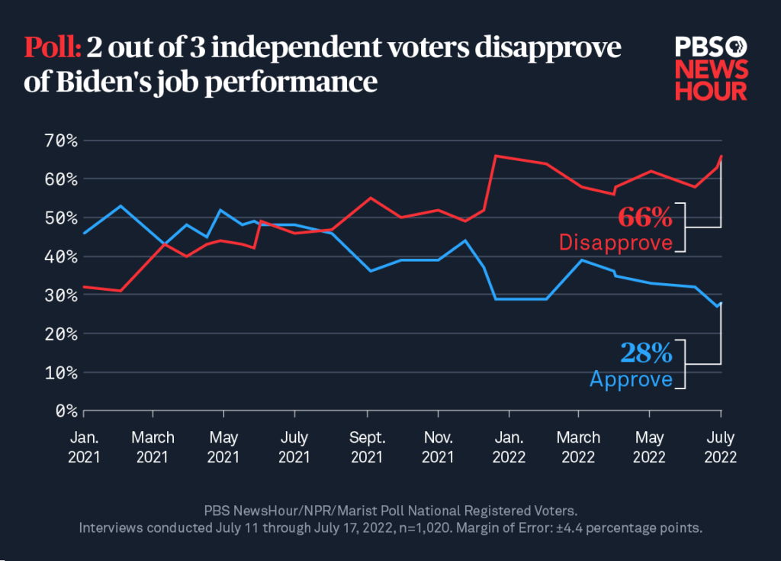
Calculating Sample Sizes: simple random sampling
PBS (Public Broadcasting Service) does this regularly (www.pbs.org)
They want to have estimates with a 99% confidence level
They are willing to have a margin of error of $±$4%
They assume the worst-case scenario (usual solution): suppose that the % of people approving (P) is the same as the % not approving (1-P)
They find that the sample size they need is roughly 1,000 citizens. How is this size calculated?

Slide 15
Calculating Sample Sizes: simple random sampling
The three ingredients are condensed in the formulas:
Constant $k$ comes from a normal distribution and gets higher if we increase the desired confidence level
Symbol $e$ stands for the margin of error we are willing to assume
We need to make and assumption on the value of P*(1-P), which is the variance of a binary (yes/no) variable. The usual solution is to suppose P=1-P=0.5, so P*(1-P)=0.25 takes its maximum value
$n^{∗}$ is the solution for a simple random sampling with replacement, $n$ is the solution for a simple random sampling without replacement and N is the population size
$$n^{∗}=k^{2}\frac{P∗(1−P)}{e^{2}}$$
$$n=\frac{n^{∗}}{1+\frac{n^{∗}}{N}}$$

Slide 16
Calculating Sample Sizes: simple random sampling
Easily implemented in R language with the package “samplingbook”
Function “sample.size.prop” allows for a sampling with or without replacement, although no practical differences will be found between the solution of these two alternatives in this example, given the large population size (N) from which the samples are drawn (we arbitrarily assume that N=200,000,000).
Solution in both cases is that approximately 1,000 citizens to be sampled

Slide 17
Calculating Sample Sizes: simple random sampling
The same three ingredients appear if we want our sample to estimate a population mean for a continuous variable
Constant $k$ comes from a normal distribution and gets higher if we increase the desired confidence level
Symbol $e$ stands for the margin of error we are willing to assume
We need to make an assumption on the homogeneity of the variable in the population. This implies that we need to impose a realistic value (usually coming from some previous study) on the population variance $σ^{2}$
$n^{∗}$ is the solution for a simple random sampling with replacement, $n$ is the solution for a simple random sampling without replacement and N is the population size
$$n^{∗}=k^{2}\frac{σ^{2}}{e^{2}}$$
$$n=\frac{n^{∗}}{1+\frac{n^{∗}}{N}}$$

Slide 18
Calculating Sample Sizes: stratified random sampling
Criteria for allocating n sample units among strata
In stratified sampling, the same basic rules (factors) that affect the optimal sample sizes apply
Additionally, the criterion applied to allocate the sample size across strata play a role as well
The most widely used allocation criteria are the proportional and the optimal
UNIFORM
Same sample sizes in all strata
PROPORTIONAL
Sample size on each stratum proportional to the population size
OPTIMAL
Sample size on each stratum proportional to the population size and its population variance

Slide 19
Calculating Sample Sizes: stratifed random sampling
The following formulas show the solutions for calculating sample sizes for:
Proportional allocation
Optimal allocation
In both cases, the formula corresponds to the estimation of the population mean for a continuous variable with a stratified sampling without replacement
$N_{j}$ stands for the size of stratum j and $σ_{j}^{2}$ for the variance of the variable on this same stratum
$$\left(1\right) n=\frac{\sum_{j=1}^{L}{N_{j}σ_{j}^{2}}}{N\frac{e^{2}}{k^{2}}+\frac{\sum_{j=1}^{L}{N_{j}σ_{j}^{2}}}{N}}$$
$$\left(2\right) n=\frac{\frac{1}{N}{\left(\sum_{j=1}^{L}{N_{j}σ_{j}}\right)}^{2}}{N\frac{e^{2}}{k^{2}}+\frac{\sum_{j=1}^{L}{N_{j}σ_{j}^{2}}}{N}}$$

Slide 20
Calculating Sample Sizes: stratifed random sampling
An illustrative example: assume that a charity is conducting a sample survey to study the annual donations made by its members, which are classified in three different groups according to their age with 100, 700 and 200 members each. They know that the respective standard deviations in the annual donations in each group are €6, €30 and €12.
We want to find the minimum sample size required to estimate the mean annual donation, setting a margin of error of €2 and a confidence level of 95%.
By calling the function “stratasize” included in package “samplingbook” in R this can be calculated for proportional and optimal allocation respectively (codes at the left, solutions at the right)

Slide 21
Summary
Sample v. population
Simple random sampling
Optimal sample sizes for simple rando sampling
Advantages of random sampling
Stratified random sampling
Optimal sample sizes for stratified sampling

Slide 22
Self-assessment test
Surveys based on samples:
A Save resources if compared with a census-based survey
B Allow for an exhaustive research in a population
C Both answers are true
Sample size is affected by:
A The margin of error and the confidence level
B The sampling technique applied
C Both answers are true
3. Proportional allocation distributes sample size across strata basing on:
A The variance in each stratum
B The size of each stratum
C The mean value on each stratum

Slide 23
Self-assessment test
Surveys based on samples:
A Save resources if compared with a census-based survey
B Allow for an exhaustive research in a population
C Both answers are true
Sample size is affected by:
A The margin of error and the confidence level
B The sampling technique applied
C Both answers are true
3. Proportional allocation distributes sample size across strata basing on:
A The variance in each stratum
B The size of each stratum
C The mean value on each stratum

Slide 24
Thank you!

